Slide 1
WEL -COME

Slide 2
Presented By
Prerana Dnyaneshwar Doke
Mayuri Sukhadev Koshti
Sanskruti Ramesh Babar
Swati Dattatray Ghadge

Slide 3
LOOPS

Slide 4
contents
Introduction
Objective
Types of Loop
Main Body
Conclusion
References

Slide 5
INTRODUCTION
Loops in programming are used to repeat a block of code until the specified condition is met. A loop statement allows programmers to execute a statement or group of statements multiple times without repetition of code. Loops in C is used to execute the block of code several times according to the condition given in the loop. It means it executes the same code multiple times so it saves code and also helps to traverse the elements of an array.

Slide 6
OBJECTIVES OF TOPIC
Understand the basics of looping
To use the while , do-while and for repetition statement to execute statements in a program repeatedly
Understand to develop a C program involving looping statements

Slide 7
Types of Loop
While Loop
Do-while Loop
For Loop

Slide 8
1. WHILE loop
A "While" Loop is used to repeat a specific block of code an unknown number of times, until a condition is met. For example, if we want to ask a user for a number between 1 and 10, we don't know how many times the user may enter a larger number, so we keep asking "while the number is not between 1 and 10".
Syntax:
While ( condition )
{
statements (S);
}

Slide 9
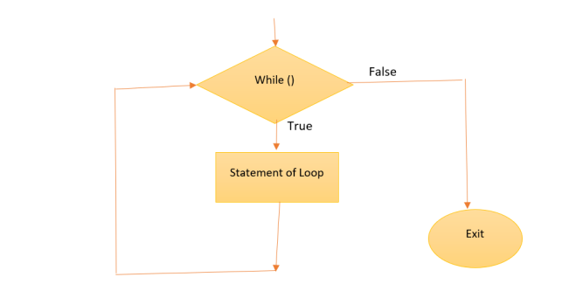
Flow chart

Slide 11
2.DO-while loop
The do-while loop in C is a control flow statement that repeatedly executes a block of code as long as a specified condition remains true. It first performs the code block and then checks the condition; thus, the block of code is executed at least once.
Syntax:
do
{
//Body of the Loop
}
While ( condition );

Slide 12
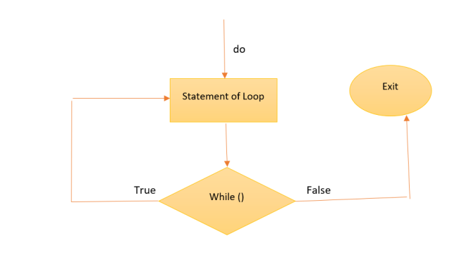
Flow chart

Slide 13
Example:
// C Program to demonstrate the use of do...while loop
#include <stdio.h>
int main()
{
// loop variable declaration and initialization
int i = 0;
// do while loop
do {
printf (“SVERI\n");
i++;
} while (i < 3);
return 0;
}
Output:
SVERI
SVERI
SVERI

Slide 14
3.For Loop
The for loop in C language is used to iterate the statements or a part of the program several times. It is frequently used to traverse the data structures like the array and linked list. Represents the initialization of the loop variable. More than one variable can be initialized.
Syntax:
For (initialization ; check expression; updation )
{
//body consisting multiple statement
}

Slide 15
Flow chart
Start
Initialization
Check condition
true
false
Block of Statements
updation
stop

Slide 16
Example:
#include< stdio.h >
int main(){
int i;
for(i=1;i<=5;i++)
{
Printf ( “PIC\n“ , i);
}
return 0;
}
Output:
PIC
PIC
PIC
PIC
PIC

Slide 17
conclusion
Loops are useful for handling complex patterns, iterating through data structures, and automating procedures.
C supports the For, While, and Do-While loop types. While the while loop is appropriate when the number of iterations is unknown but depends on a condition, and the do-while loop is used when you want to guarantee that the loop body executes at least once, the for loop is used when the number of iterations is known in advance.
Using loop control statements like break, continue, and goto, loops can be managed. These statements give us the ability to alter how a loop executes, allowing us to skip a few iterations, exit the loop early or go to a labelled statement.

Slide 18
References
Book – Let’s C
https://www.techtarget.com/whatis/definition/loop

Slide 19


